Slide 1



Crops and Fertilizers
Recommendation System
Using ML

Slide 2

Learning Objectives
Learn how machine learning can help in agriculture.
Understand how to clean and prepare data for machine learning.
Build models to recommend crops and fertilizers based on conditions.
Evaluate the performance of the models.
Create an interactive interface for real-time predictions.
GOAL
Source :
www.freepik.com/

Slide 3
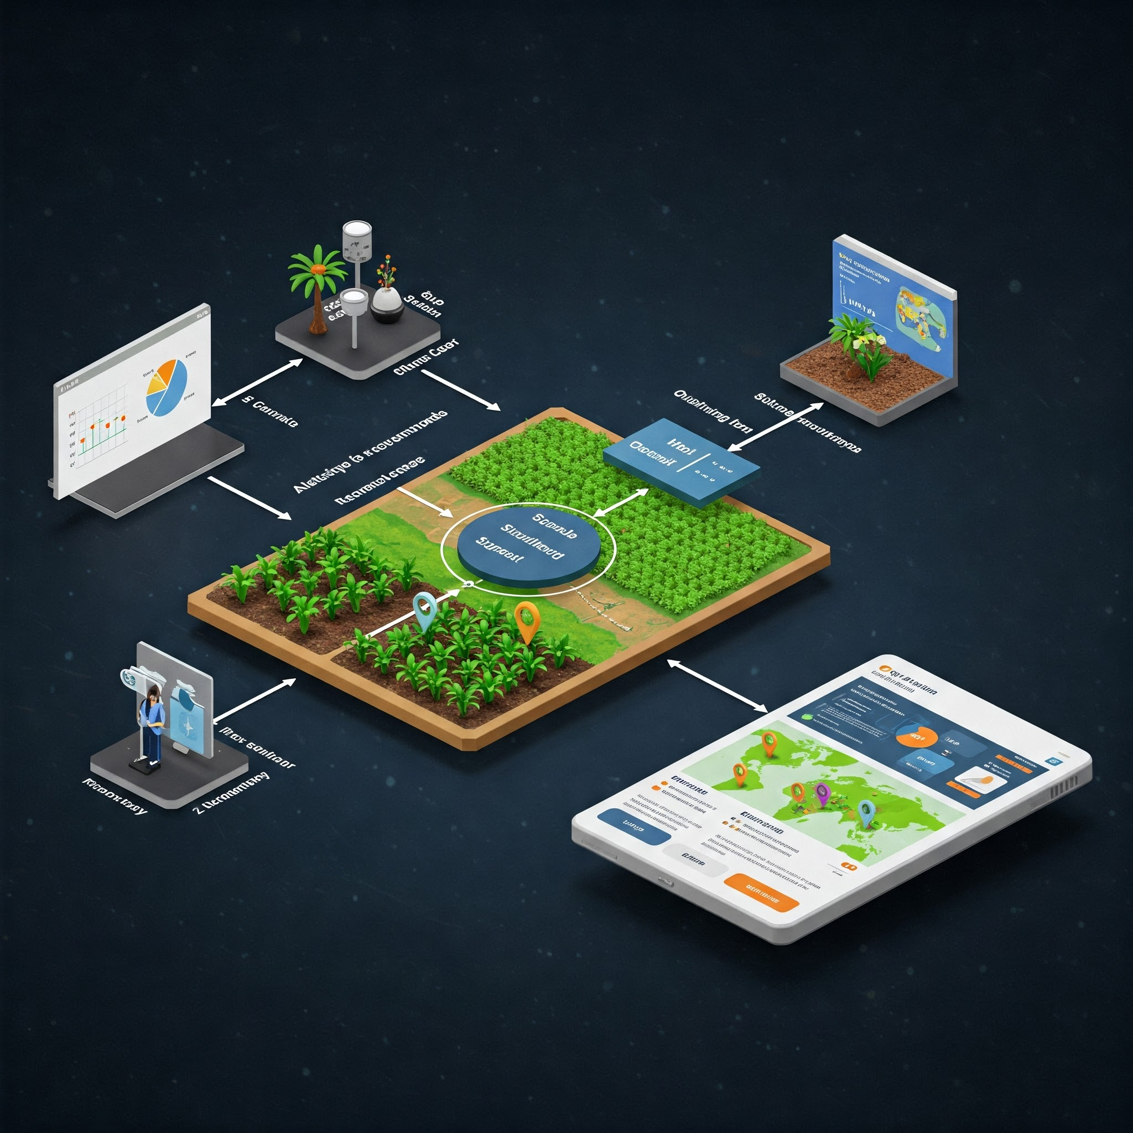
Tools and Technology used
Python: Programming language used for developing the system.
Machine Learning Libraries:
Scikit-learn: For building and training machine learning models.
Pandas: For data manipulation and analysis.
NumPy: For numerical operations.
Seaborn & Matplotlib: For data visualization.
Jupyter Notebook: Development environment for writing and testing the code.
ipywidgets: For creating interactive UI elements for input and output.
Decision Tree Classifier: The machine learning model used for crop and fertilizer recommendation.

Slide 4
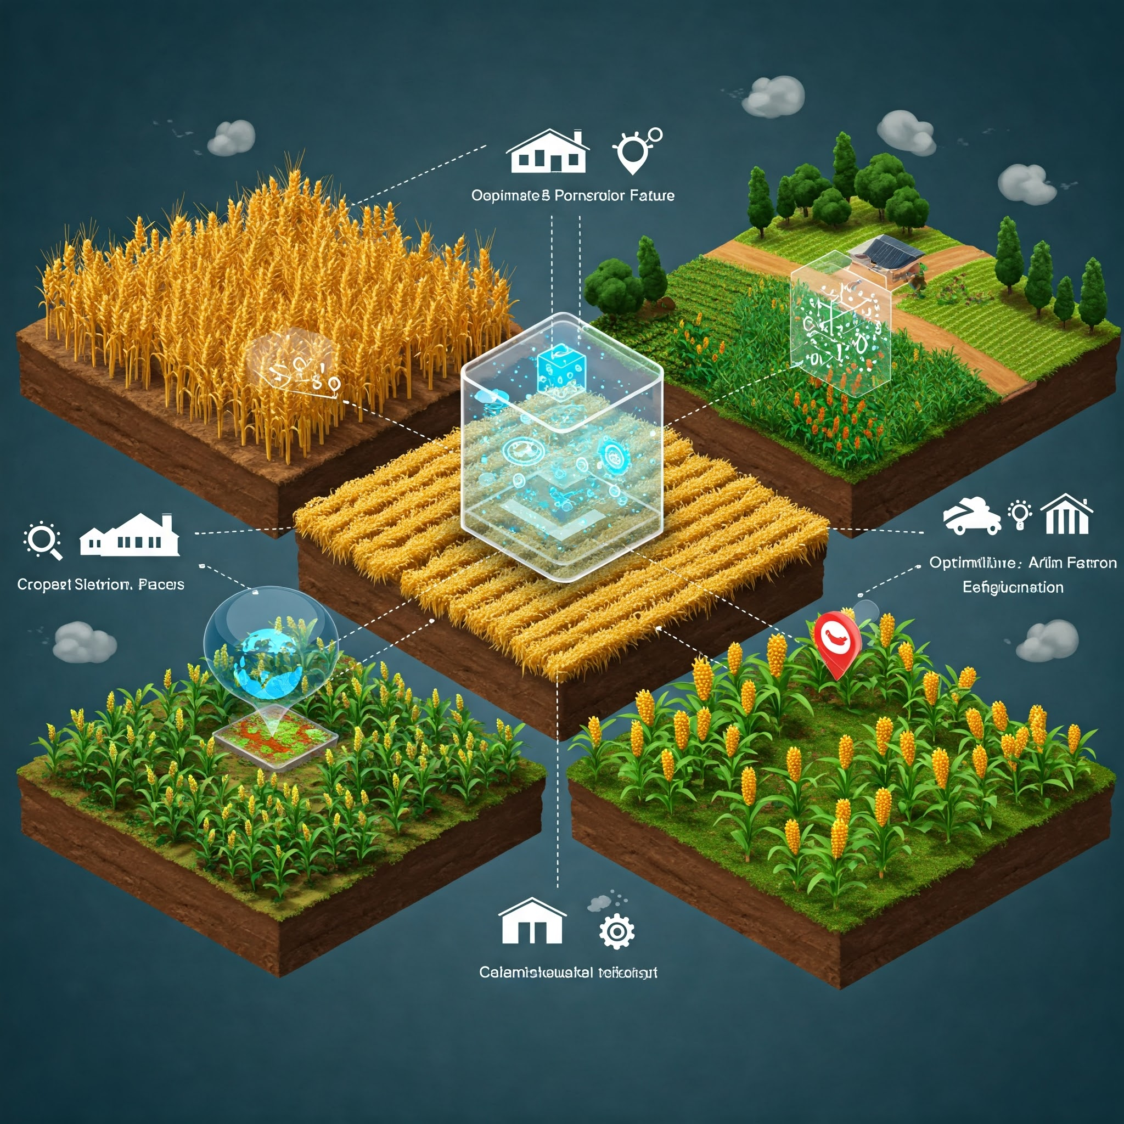
Methodology
Data Collection:
Collected datasets for crop recommendations and fertilizer prediction.
Data Preprocessing:
Cleaned and handled missing values.
Encoded categorical variables into numerical values.
Scaled the data to ensure consistency.
Model Development:
Used Decision Tree Classifier to build models for crop and fertilizer
recommendations.
Model Training:
Split the data into training and testing sets.
Trained the models using the training data.
Model Evaluation:
Evaluated the models' performance using accuracy scores on the test data.
Prediction Interface:
Built an interactive user interface using ipywidgets for real-time crop and fertilizer recommendations.

Slide 5
Problem Statement:
Challenge in Agriculture: Farmers often face difficulties in selecting the right crop and the appropriate fertilizers based on varying environmental and soil conditions.
Objective: Develop a machine learning-based system that:
Recommends the most suitable crop for a given set of conditions (soil, climate, nutrients).
Suggests the best fertilizer based on the selected crop and soil type.
Impact: This system will help farmers make informed decisions, increase crop yields, and improve soil health by ensuring the right fertilizers are used.

Slide 6
Solution:
Machine Learning-based System:
We developed a recommendation system using machine learning to predict the best crop and fertilizer for a given environment.
Two Main Components:
Crop Recommendation: Based on factors like nitrogen, phosphorus, potassium levels, temperature, humidity, pH, and rainfall.
Fertilizer Recommendation: Suggests the most suitable fertilizer based on soil type, crop type, and nutrient requirements.
Interactive User Interface:
An easy-to-use interface created using ipywidgets allows farmers to input their conditions and receive instant recommendations.
Benefits:
Helps farmers choose the right crops and fertilizers for better yield and healthier soil.
Saves time and reduces errors in decision-making.

Slide 7
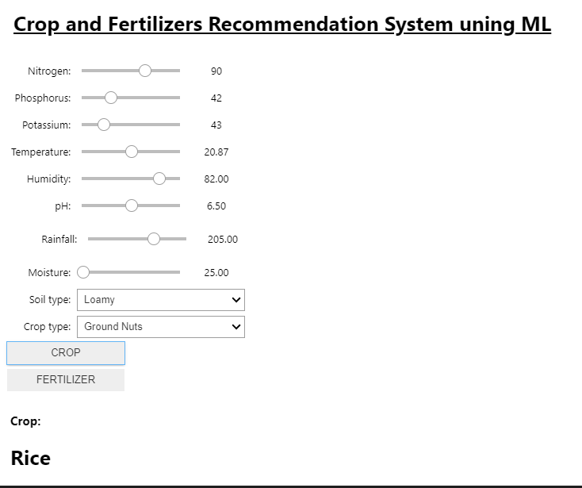
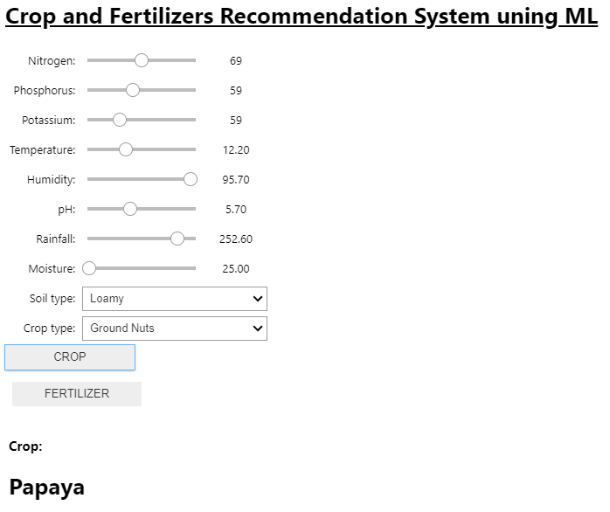
Screenshot of Output:
Crop Recommendation
Test 1
Test 2

Slide 8


Screenshot of Output:
Fertilizer Recommendation
Test 3
Test 4

Slide 9
Conclusion:
The Crop and Fertilizer Recommendation System provides accurate predictions using machine learning.
It helps farmers select the best crop and fertilizer based on environmental and soil conditions.
The system is built using Decision Tree Classifier and trained on relevant agricultural datasets.
An interactive user interface makes it easy for users to input values and get instant recommendations.
This solution can improve crop yield, soil health, and decision-making in farming.
Future enhancements may include advanced models, real-time data integration, and mobile application support.
I have uploaded the source code for this project on my GitHub repository. You can access it here:https://github.com/Tamilnavi/week1.git
Thank You

